Slide 1

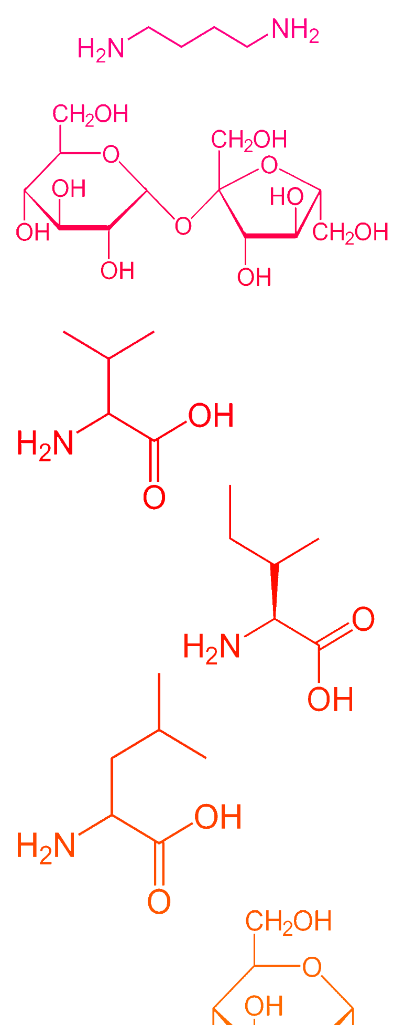
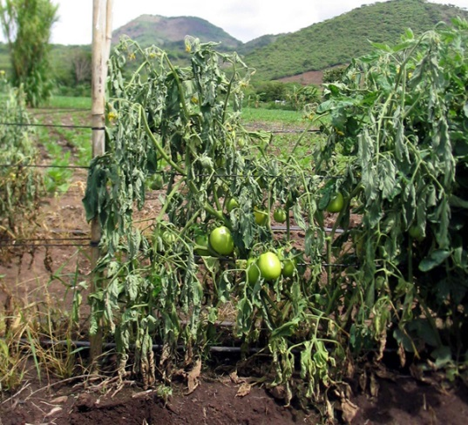
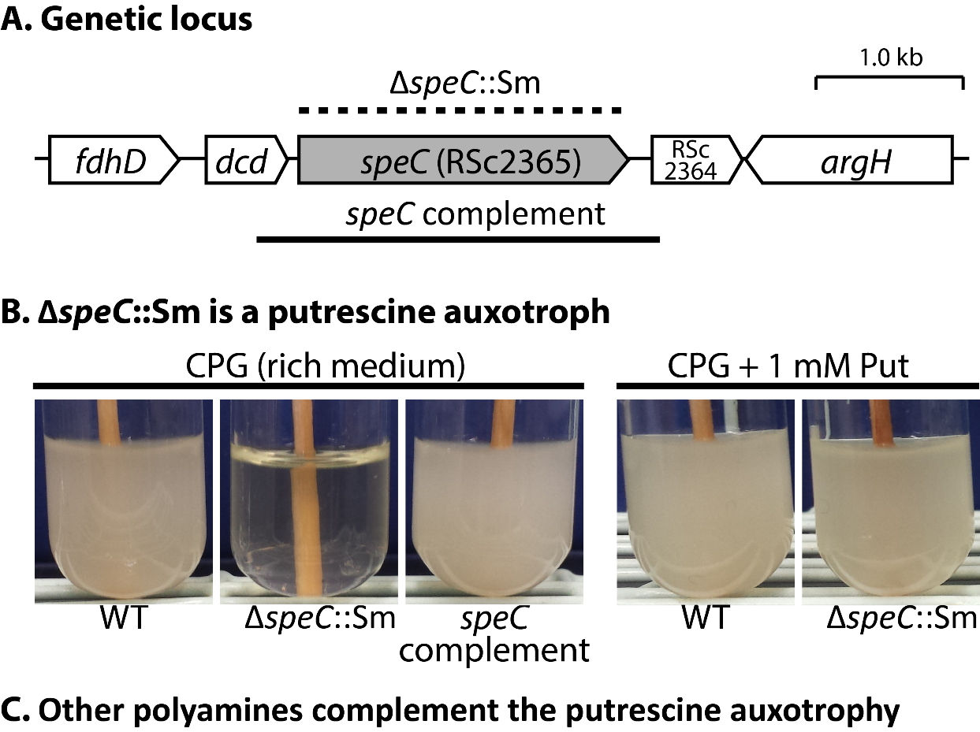
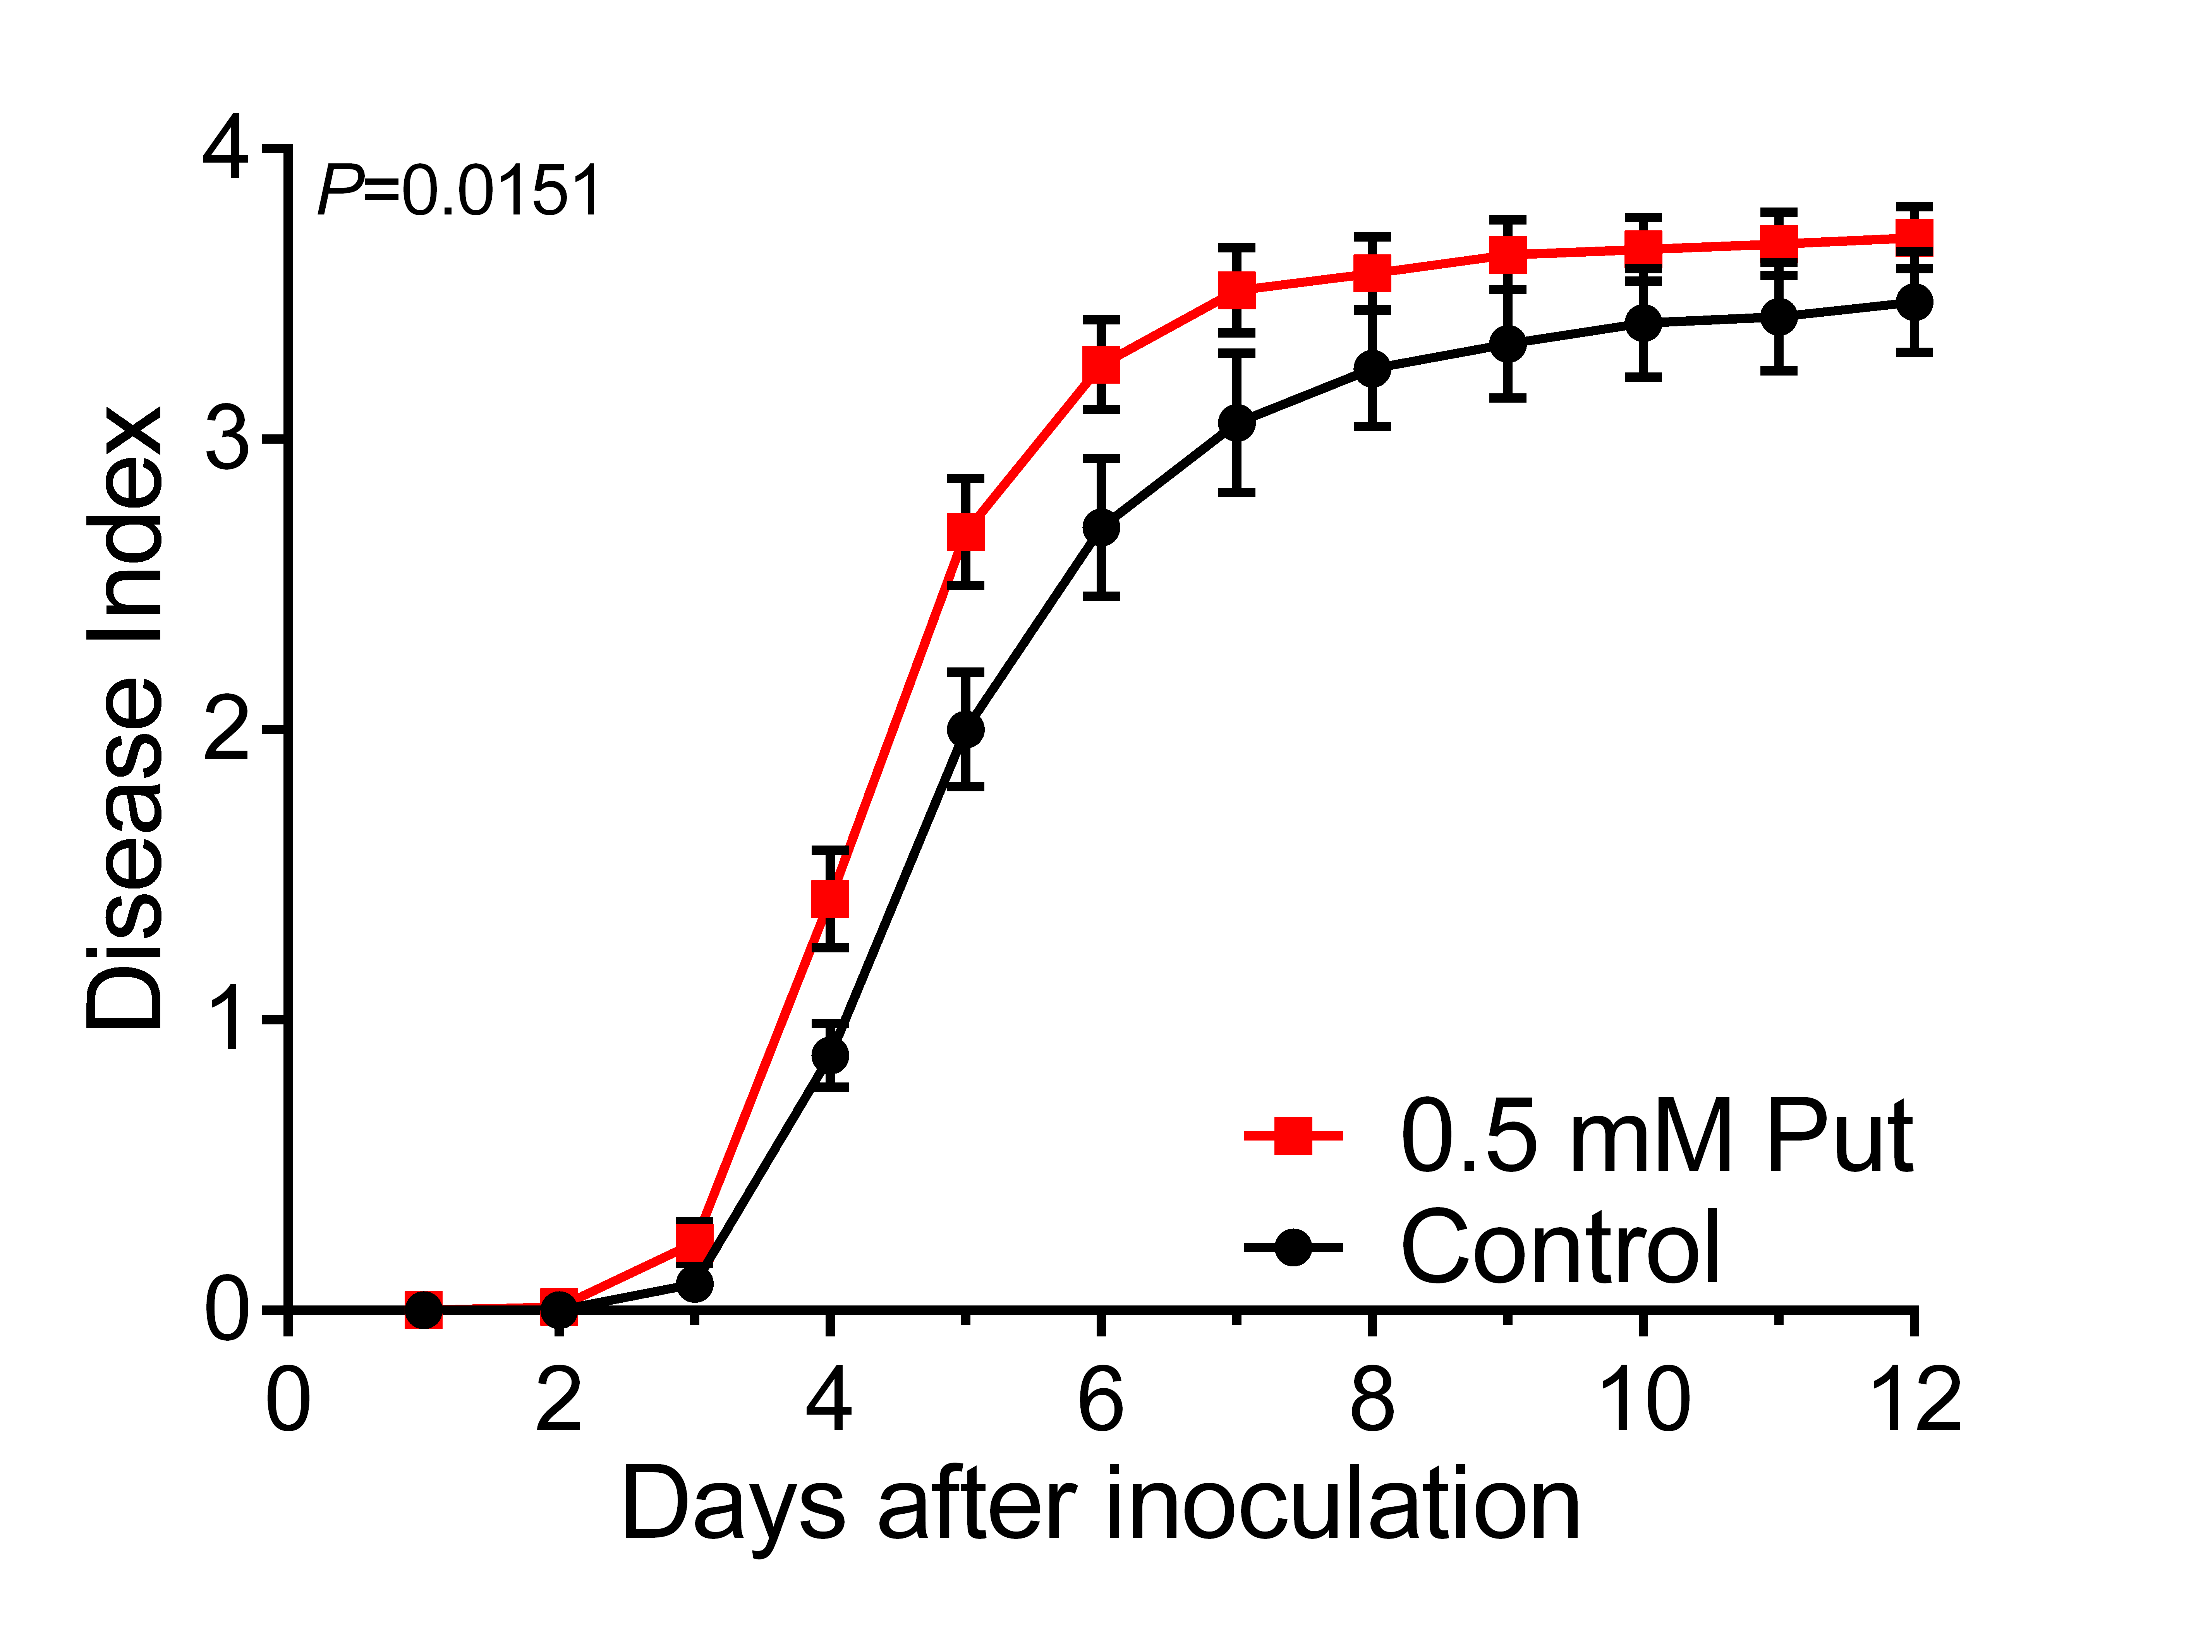
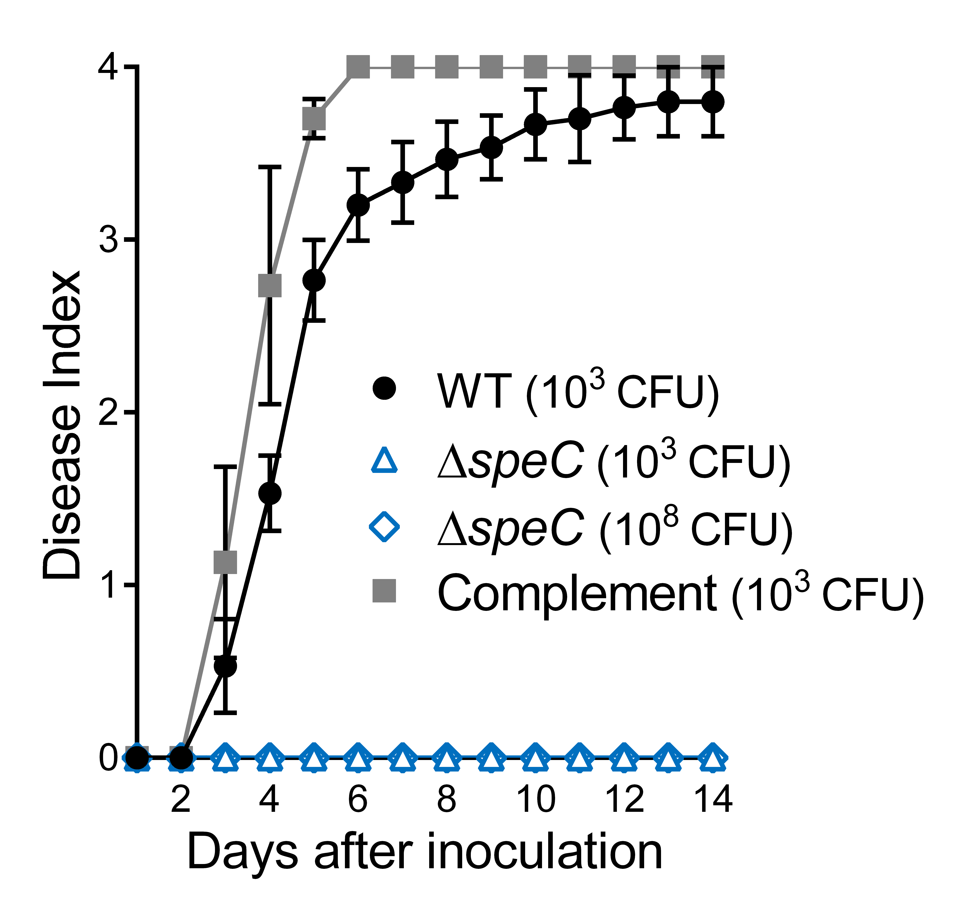
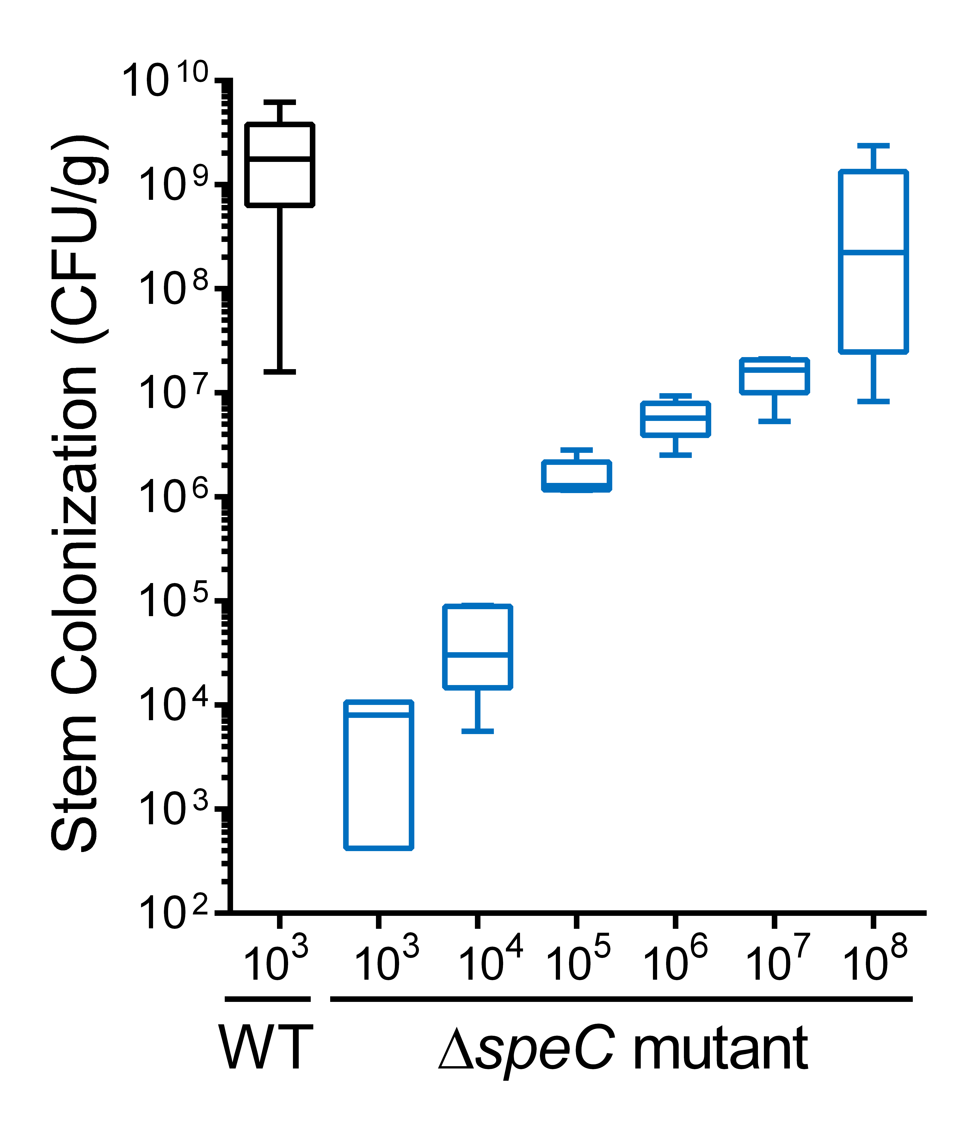
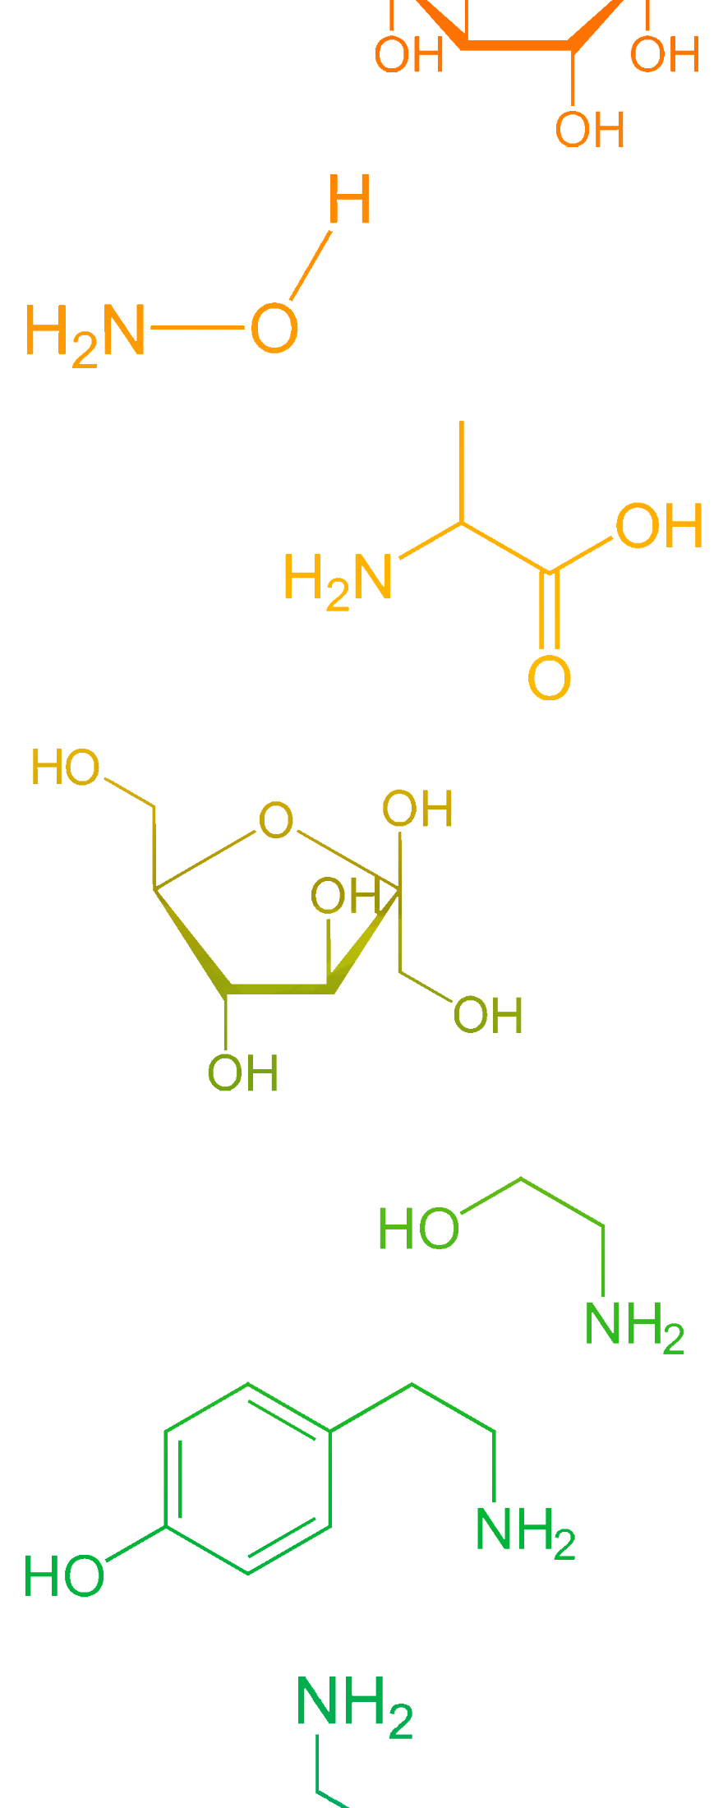

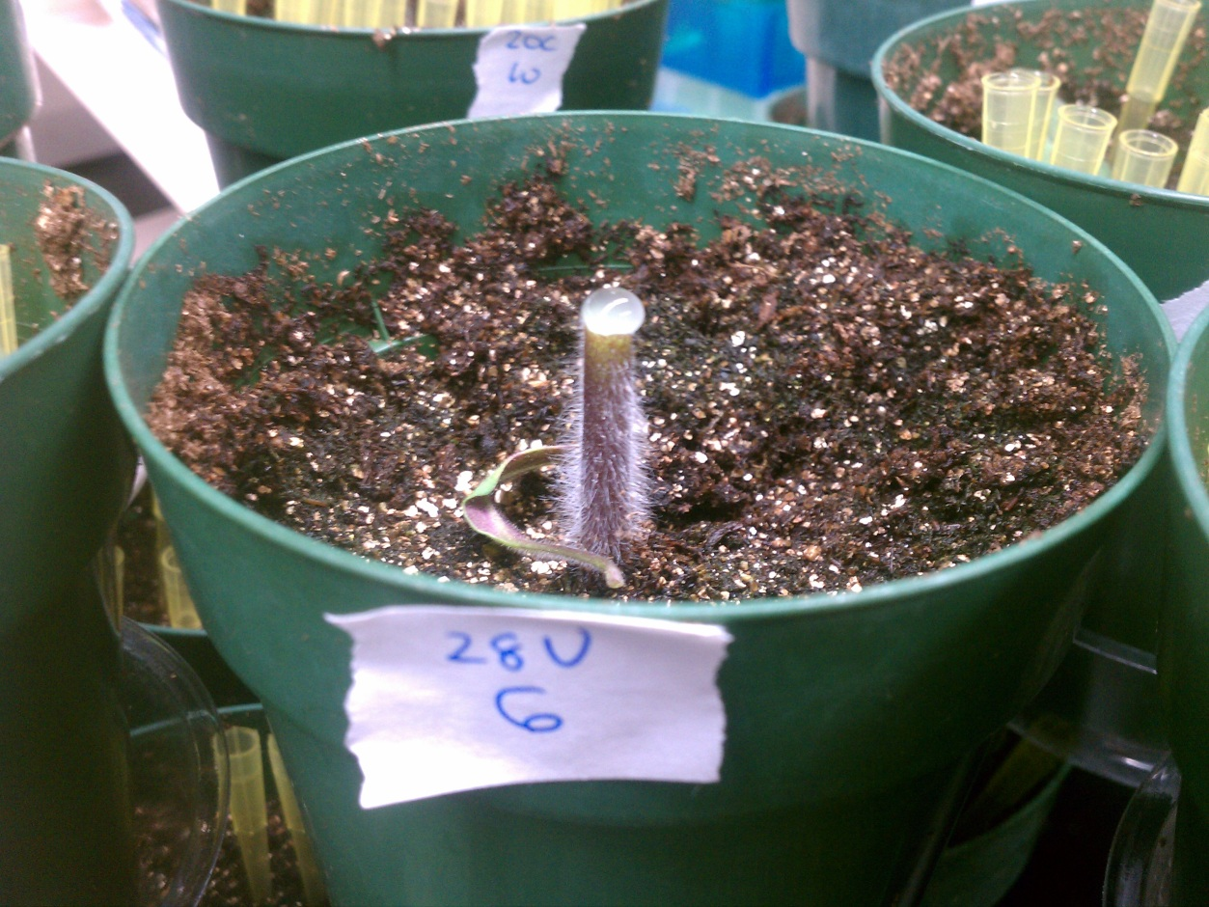
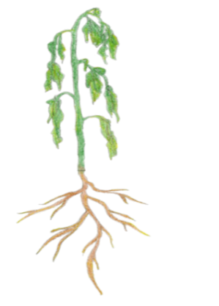

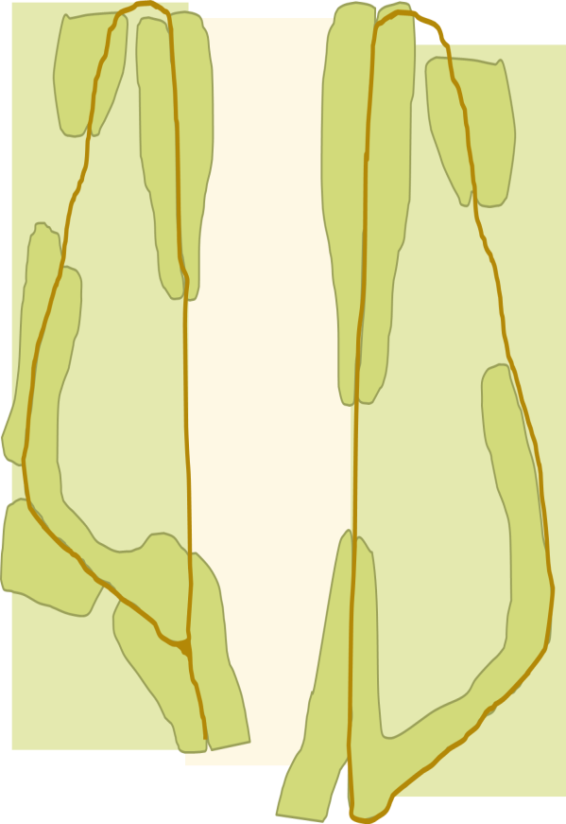
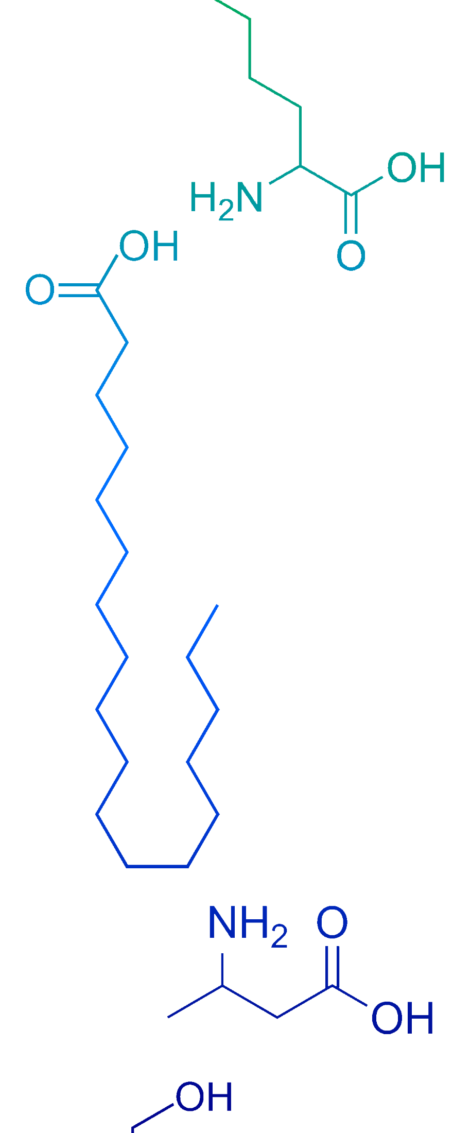
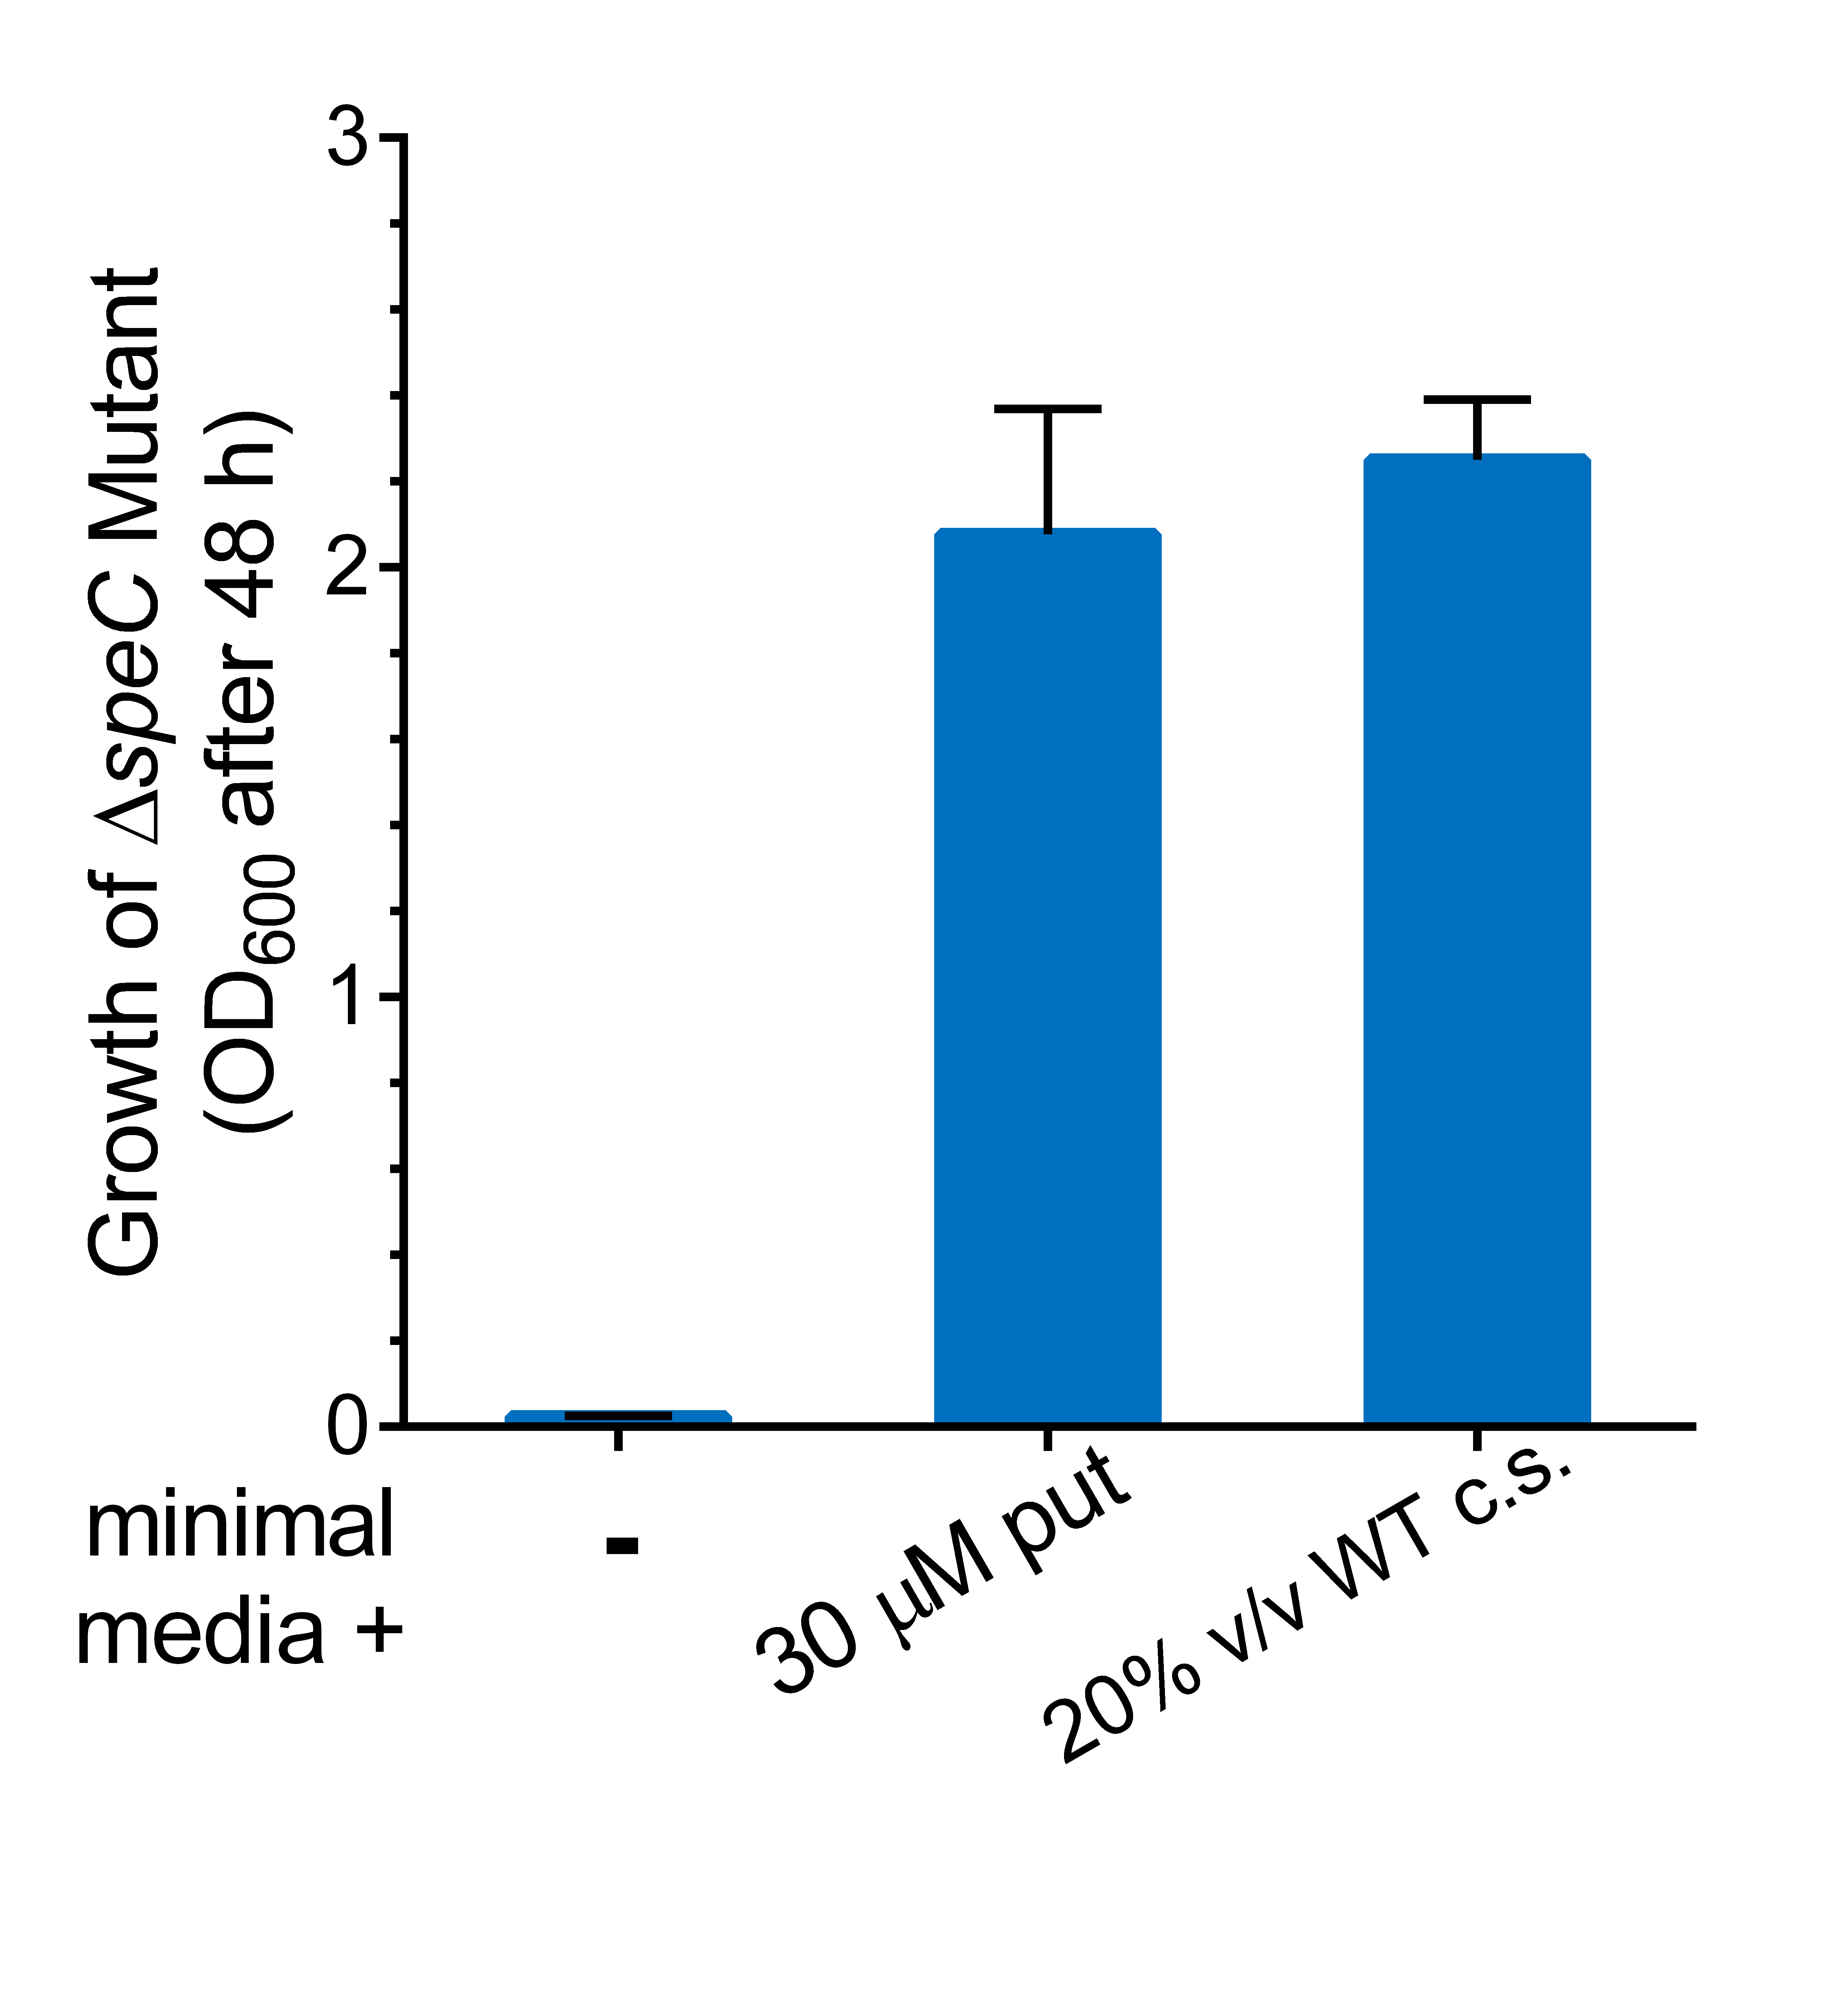
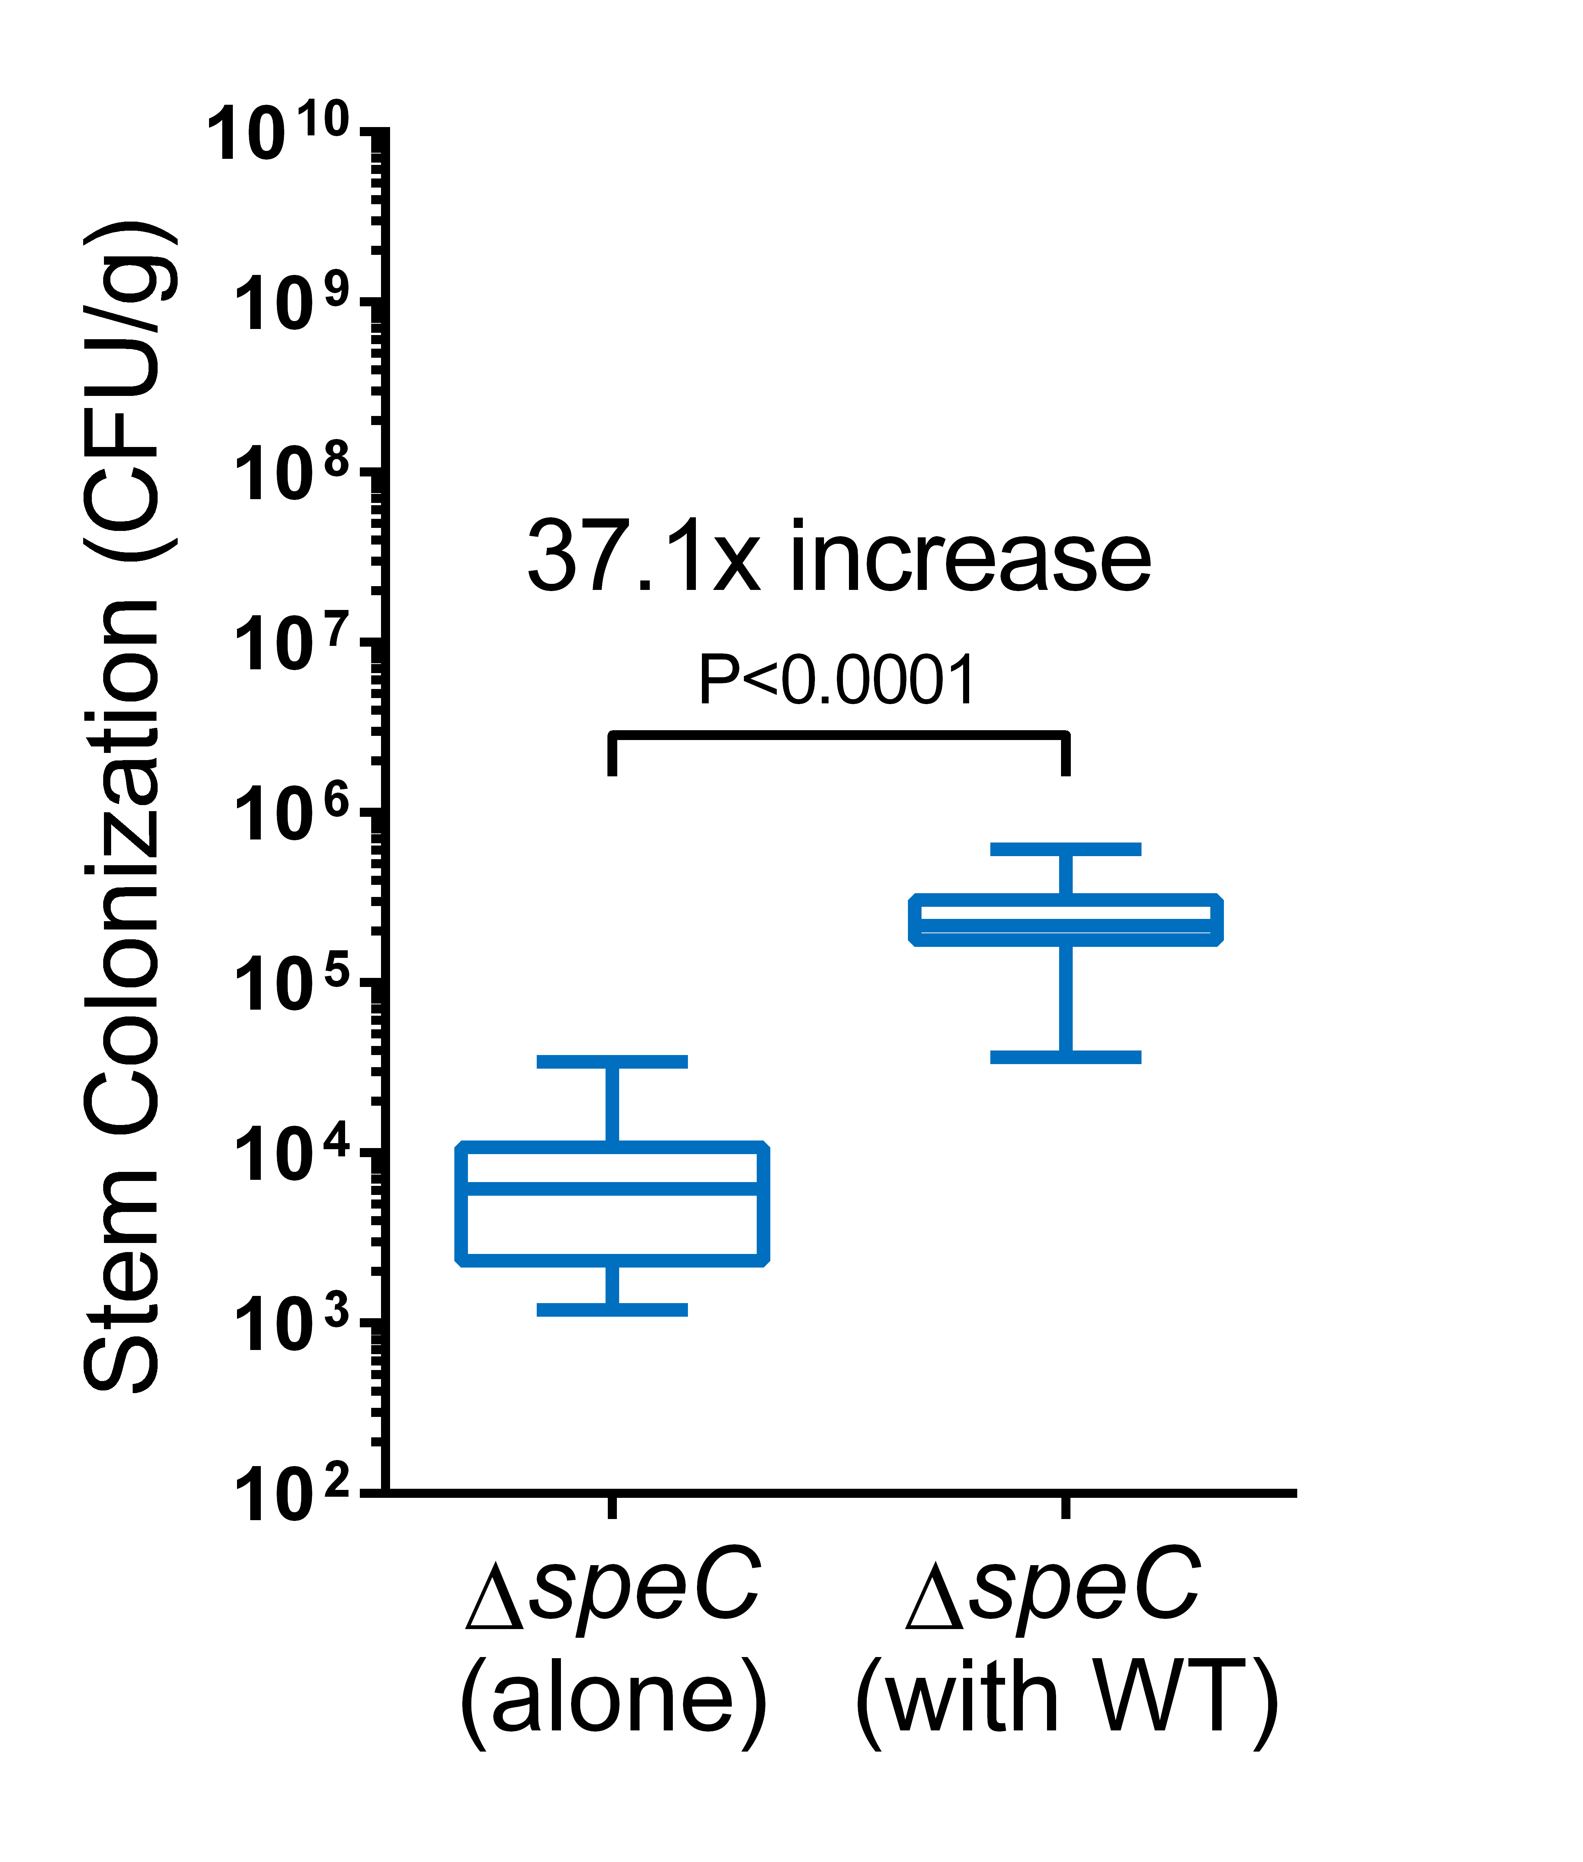
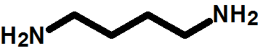
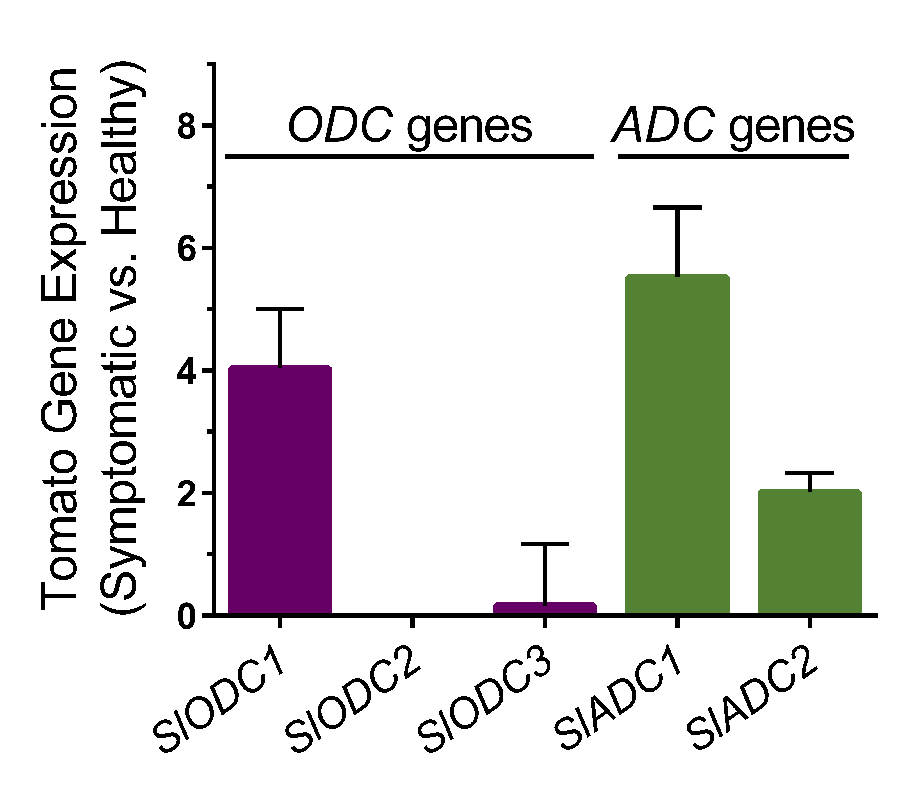
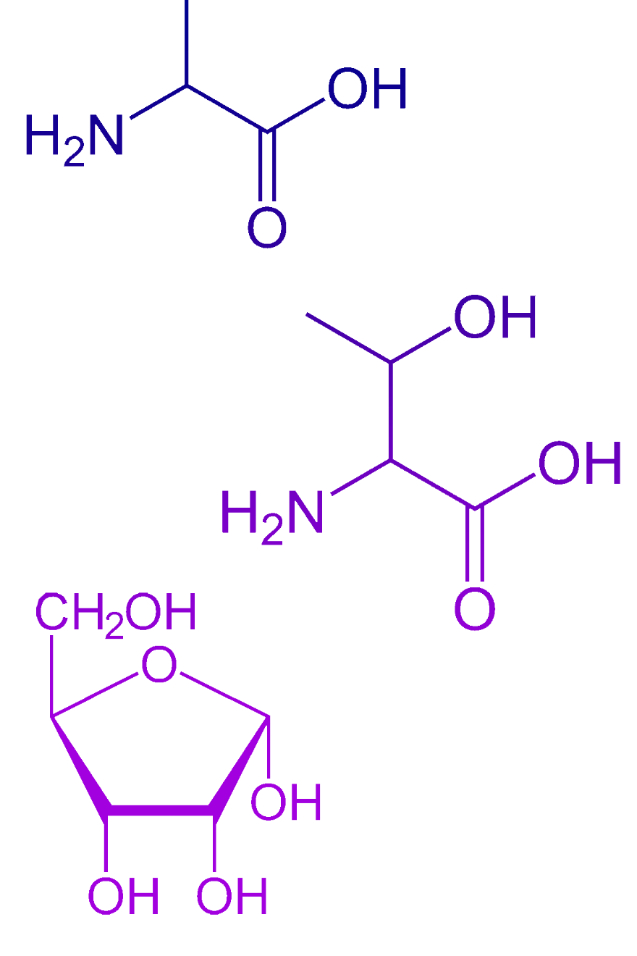









Metabolomics reveals putrescine is involved in Ralstonia solanacearum-host interactions
Metabolomics reveals putrescine is involved in Ralstonia solanacearum-host interactions
Tiffany M Lowe-Power¹, Beth Dalsing¹, Amy Jancewicz¹, Bin Li², Raka Mitra³, Patrizia Ricca⁴, Dousheng Wu, Edda Von Roepenack-LaHaye⁴, Patrick Masson¹, Anthony J Michael², and Caitilyn Allen¹ ¹Univ. of Wisconsin-Madison, USA ²Univ. Texas Southwestern, USA ³Carleton College, USA ⁴Univ. Tubingen, Germany
Take Home Points
Rs infection enriches putrescine , carbon sources, and nitrogen sources in tomato xylem sap
Putrescine treatment accelerates Rs symptoms
Although both tomato and Rs produce putrescine, current data suggest Rs produces most of the putrescine
Background: Bacterial wilt disease
Take Home Points
Rs infection enriches putrescine , carbon sources, and nitrogen sources in tomato xylem sap
Putrescine treatment accelerates Rs symptoms
Although both tomato and Rs produce putrescine, current data suggest Rs produces most of the putrescine
Background: Bacterial wilt disease
Rs ΔspeC mutant is a putrescine auxotroph
Rs ΔspeC mutant is a putrescine auxotroph
R. solanacearum (Rs) infects xylem vessels and causes bacterial wilt disease
Xylem sap is nutrient-poor, but Rs grows to >10⁹ CFU/ g stem. How?
1.
CPG (low in putrescine)
CPG + 1 mM putrescine
Aim: Use metabolomics to understand how Rs manipulates xylem sap.
WT
ΔspeC
Complement
WT
ΔspeC
Rs-infected tomato plant
Rs putrescine auxotrophy abolishes virulence
Putrescine accelerates Rs symptoms
Rs putrescine auxotrophy abolishes virulence
Tomato xylem sap metabolomics
Putrescine accelerates Rs symptoms
Tomato xylem sap metabolomics
Experiment Overview
Exogenous putrescine accelerates Rs wilting. Putrescine was applied to tomato leaves and soil 3 hr before 50 CFU Rs were petiole inoculated Putrescine did not wilt non-inoculated plants. N=175 plants
Healthy Bonny Best tomato plants
GC-MS at UC-Davis metabolomics core (West Coast Metabolomics)
Sample size:
N=5 pools of 4 samples
Symtomatic, Rs-infected plants
Plants detopped and xylem sap harvested for 30 min
Rs strain
GMI1000
Rs infections enrich 34 compounds
(P<0.05 by t-test; Fold Change>1.5)
ΔspeC is avirulent. Tomato plants petiole inoculated with ΔspeC did not develop symptoms. N=30 plants
ΔspeC does not grow in tomato. ΔspeC population sizes in plants 3 dpi mirror the inoculum dose. In contrast, WT grew. N=5 plants
Rs infections enrich 34 compounds
Putrescine could come from either tomato or Rs
Putrescine could come from either tomato or Rs
Putrescine
Tomato Put Synthesis
Rs Put Synthesis
WT Rs exports enough putrescine to partially rescue ΔspeC growth defect
Ornithine
WT Rs exports enough putrescine to partially rescue ΔspeC growth defect
SpeC
(ODC)
Ornithine
ODC
Putrescine
Arginine
ADC
AIH
CPA
ODC: ornithine decarboxylase and ADC: arginine decarboxylase
Rs infection induces expression of tomato putrescine synthesis genes
Rs infection induces expression of tomato putrescine synthesis genes
Rs induces expression of SlODC1, SlADC1, and SlADC2. Plants were soil-soak inoculated with Rs. At first symptoms, stem RNA was harvested and analyzed with RT-qPCR. N=3
WT culture supernatant (c.s.) rescues ΔspeC growth in vitro. N=3
Co-inoculation with WT partially rescues ΔspeC growth in tomato. N=20 plants
n.d.
Time-Lapse Video: Bacterial Wilt of Tomato
Filmed by Jon Jacobs
To watch the video, scan the QR code with a smartphone QR reader application, or go to www.vimeo.com/74855449
Putrescine is >60-fold enriched in infected sap (30 µM)
MPMI

